Slide 1

STOCK PRICE PREDICTION USING LSTM
2103A52027 POLSANI CHAITHRA SRI
2103A52050 KADARLA MITHRASRI
2103A52035 THATIKONDA SAITEJA
2103A52037 UGGE REETHU VARMA
2103A52019 JULURI KEERTHAN

Slide 2
Abstract
Stock price prediction is crucial for informed financial decision-making. This study introduces a model leveraging Recurrent Neural Networks (RNN) and Long Short-Term Memory (LSTM) to forecast Google stock prices. Historical stock data spanning 20 years was obtained from the Yahoo Finance API and preprocessed using MinMaxScaler. Key metrics, such as percentage changes, adjusted closing prices, and 100- and 250-day moving averages, were calculated. Sequences of 100 days served as input for predicting the next day's price. The LSTM model, with two LSTM layers followed by dense layers, was trained on 70% of the dataset and tested on the remaining 30%, achieving a Root Mean Square Error (RMSE) of 4.31. Other ML models like Random Forest and XGBoost were explored to enhance accuracy. Predictions were scaled back for validation, and a Streamlit-based interface was developed for real-time forecasts. The study highlights LSTM's efficacy in time-series forecasting for stock market decisions.

Slide 3
INTRODUCTION
Stock price prediction has gained significance with advancements in machine learning (ML) and artificial intelligence (AI), improving accuracy in forecasting volatile markets. Methods like ensemble learning combine data from sources such as social media, search trends, and news to enhance reliability. Deep learning models like Long Short-Term Memory (LSTM) and Recurrent Neural Networks (RNN) outperform traditional techniques, especially in time-series tasks. LSTM-based models, with their temporal modeling capabilities, have demonstrated success in optimizing investment strategies. Additionally, Transformer models are emerging as top performers in financial time-series forecasting, surpassing other deep learning frameworks.
Sentiment analysis plays a vital role in enhancing stock prediction accuracy by analyzing social media and financial news to gauge market sentiment. Hybrid models, which integrate sentiment analysis with techniques like Off-policy Proximal Policy Optimization (PPO), further refine predictions. Advanced architectures, including LSTM-DNN and Bi-LSTM, combined with optimization algorithms, have significantly improved forecasting. Blockchain-based real-time models and reinforcement learning methods show promise for handling dynamic financial data. These innovations, coupled with systematic reviews highlighting AI's effectiveness, showcase the potential of AI-driven models to revolutionize financial decision-making.

Slide 4
MOTIVATION
Our team chose this stock price prediction project because, as a group of Computer Science and Engineering (CSE) students eager to apply technology to impactful real-world challenges, we were drawn to the complexities of financial forecasting. Stock price prediction has the potential to empower investors with data-driven insights, improve financial decision-making, and contribute to more efficient market operations. Moreover, we believe that developing this project will enhance our skills in deep learning, particularly in time-series analysis and model optimization. It provides an opportunity to tackle a complex and impactful problem, fostering creativity and innovation that aligns with our technical aspirations. This project is a significant step toward achieving our individual and collective goals in AI and data-driven technologies. It was chosen because it integrates our team’s interests, expertise, and ambition to make a meaningful contribution to the field of financial technology.

Slide 5
LITERATURE REVIEW
Historical Models: Traditional methods like ARIMA, Moving Averages, and Exponential Smoothing have been used for stock predictions. However, these models often fail to capture the complexities of the market.
Machine Learning Approaches: Recent studies use machine learning techniques like Random Forest, XGBoost, and LSTM (Long Short-Term Memory). LSTM is particularly suitable for sequential data like stock prices due to its ability to remember long-term dependencies.
Advanced Techniques: Other researchers have applied hybrid models combining multiple techniques, but none perfectly capture the full volatility of the market.

Slide 6
Existing Method Vs Proposed Method
Traditional methods rely on statistical analysis (ARIMA, Moving Averages) that may not capture non-linear patterns effectively. Existing machine learning models like Random Forest or SVM fail to account for sequential dependencies in time-series data.
Proposed Method: Using LSTM and RNN models to capture long-term dependencies in the stock market data. Incorporating 100-day, 200-day, and 250-day moving averages as features to improve prediction accuracy. A real-time web-based tool that allows users to interact with the predictions and visualize the results in a more intuitive way.

Slide 7
OBJECTIVE
Primary Goal: To predict stock prices using machine learning models, focusing on historical stock data, and analyze trends over time.
Sub-Goals: Collect and preprocess historical stock data (e.g., 100, 200, and 250-day moving averages).Develop a prediction model using LSTM and RNN to accurately predict stock prices based on historical trends. Visualize trends and provide user-friendly stock analysis for better decision-making.

Slide 8
DATASET
The dataset, sourced from Yahoo Finance (YFinance), contains Google’s historical stock prices over 20 years, spanning October 11, 2004, to October 8, 2024. Comprising 5,033 rows and 6 columns, it offers a comprehensive view of Google’s stock performance. Using Yahoo Finance’s API, users can extend their analysis to other major companies like Apple, Microsoft, Amazon, Tesla, Meta, and NVIDIA. This flexibility allows for broader stock price prediction applications across multiple industries.
Key dataset columns include Open, High, Low, Close, Adjusted Close, and Volume, each capturing critical trading day metrics. The Adjusted Close column accounts for factors like stock splits and dividends, ensuring accuracy in analysis. This structured data format enables detailed stock performance evaluations and facilitates the development of predictive models for informed financial decision-making.

Slide 9
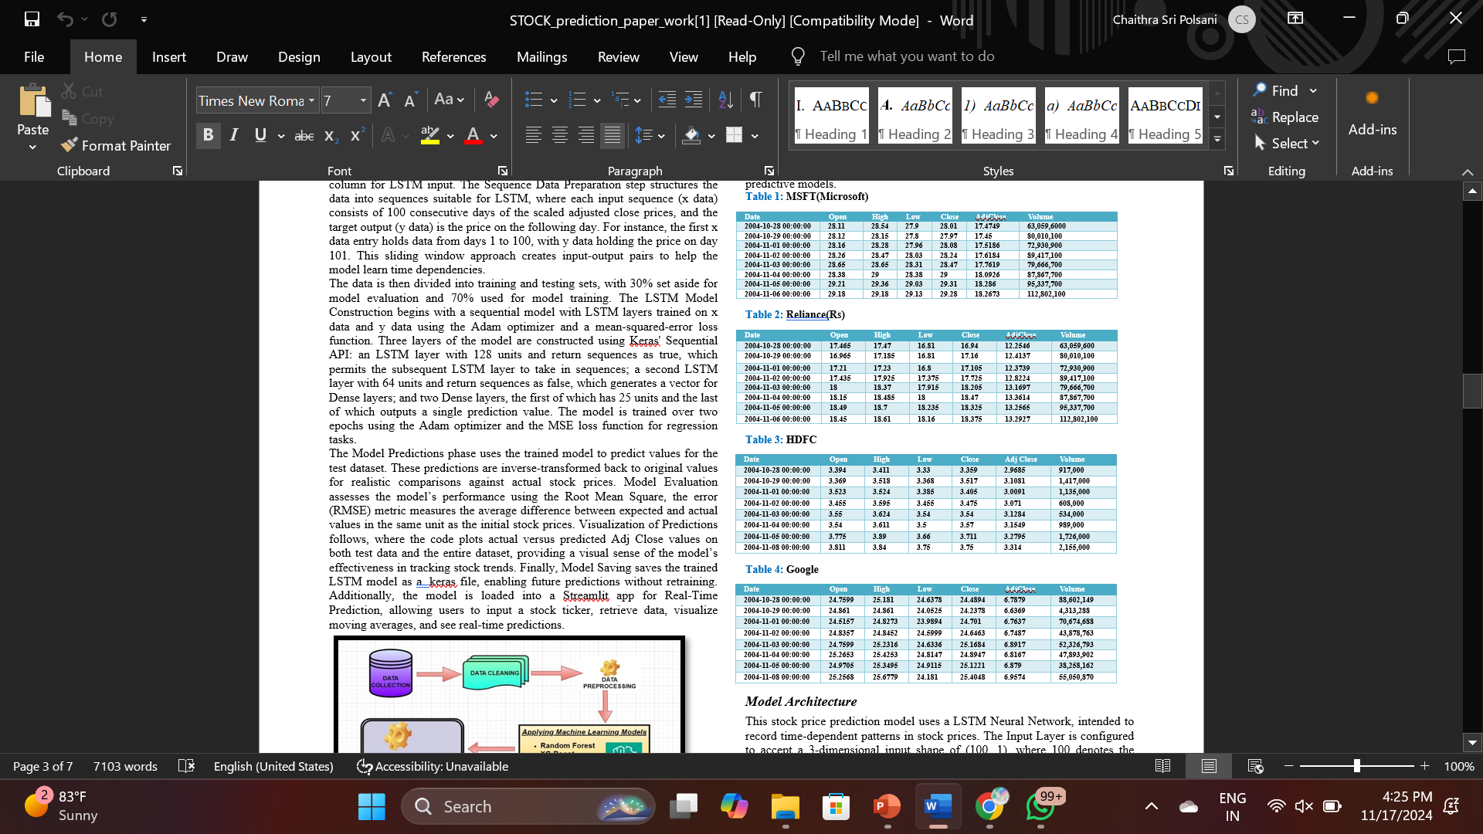

Slide 10
METHODOLOGY
The proposed methodology aims to develop a stock price prediction model for Google using historical data from Yahoo Finance, spanning from 2004 to 2024. The process begins with Data Acquisition through the yfinance library, collecting key stock metrics such as Open, High, Low, Close, Adjusted Close, and Volume. Following Data Exploration and Cleaning, the dataset is analyzed for integrity, ensuring no missing values, while Data Visualization highlights trends, especially the Adjusted Close prices. In Feature Engineering, 100-day and 250-day moving averages are introduced to identify short- and long-term trends, and daily percentage changes are calculated to measure volatility. Data Normalization scales the Adjusted Close prices between 0 and 1 to prepare for LSTM input, and Sequence Data Preparation forms 100-day input sequences to predict the next day’s stock price. The dataset is split into training (70%) and testing (30%) sets, and the LSTM Model is constructed with two LSTM layers and dense layers, trained using the Adam optimizer and mean-squared-error loss function. Model performance is evaluated using RMSE, and predictions are visualized alongside actual stock prices. Finally, the trained model is saved and integrated into a Streamlit app for real-time predictions and stock trend analysis.

Slide 11
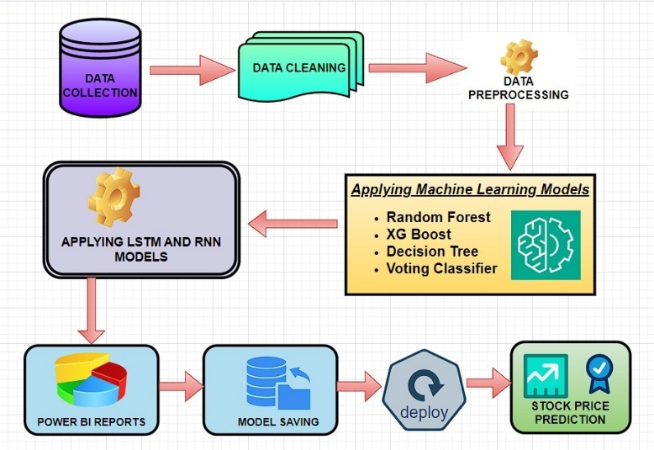
. Architecture of proposed model

Slide 12
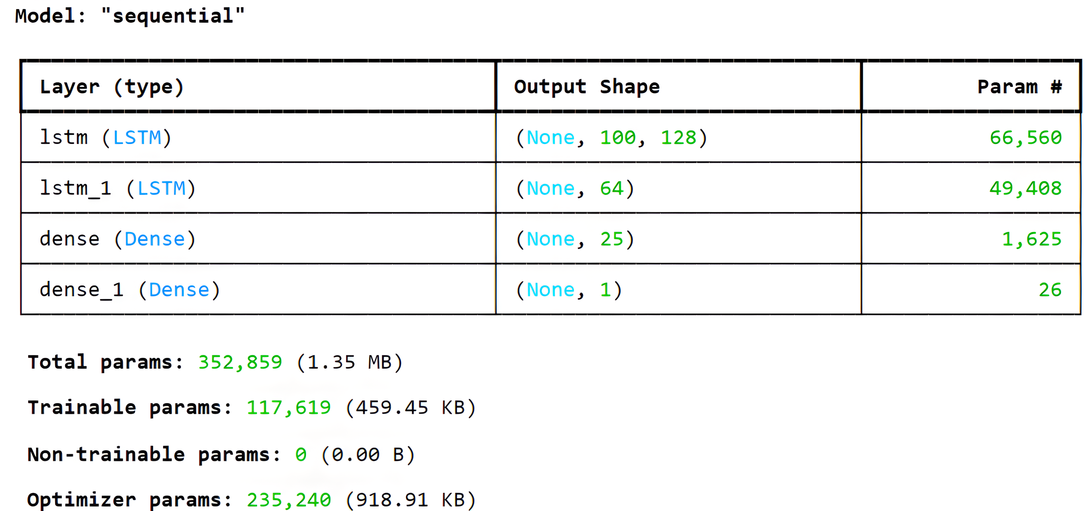
Model Architecture
This LSTM-based deep-learning algorithm was created especially for historical stock price time series forecasting., leveraging multiple LSTM layers to capture long-term dependencies, followed by dense layers for further processing, and optimizing with MSE to ensure precise predictions of stock prices over time.

Slide 13
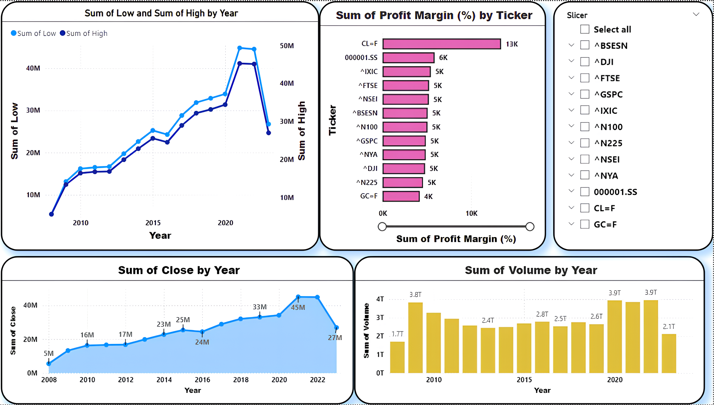
DATA ANALYSIS
Chart 1: Sum of Low and Sum of High by Year
Chart 2: Sum of Profit Margin (%) by Ticker
Chart 3: Sum of Close by Year
Chart 4: Sum of Volume by Year

Slide 14
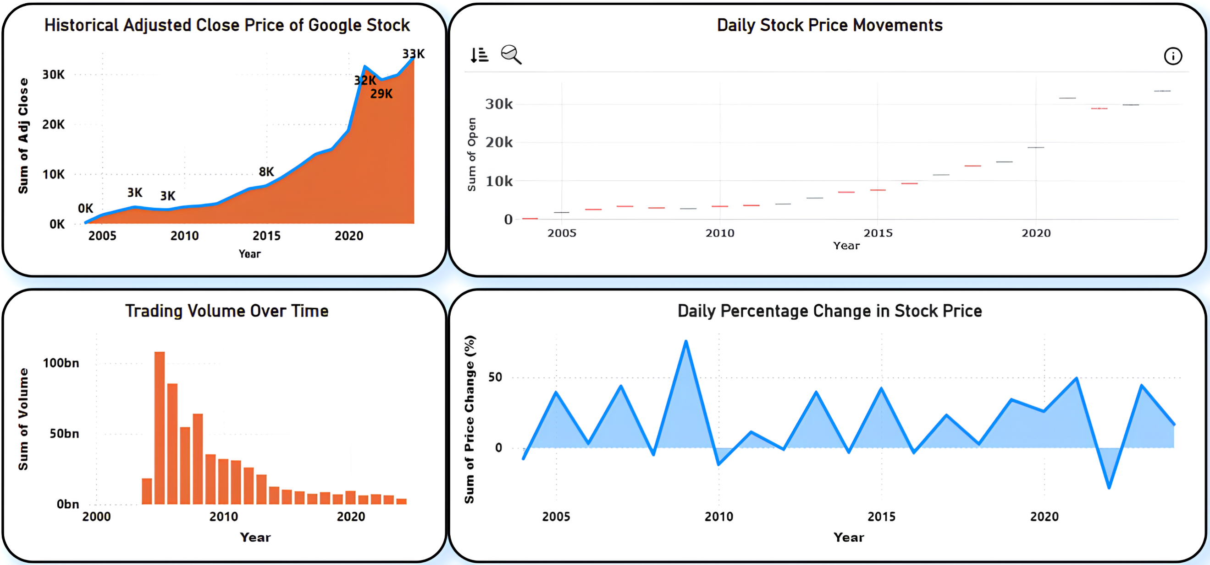
Chart 1: Historical Adjusted Close Price of Google Stock
Chart 2: Daily Stock Price Movements
Chart 3: Trading Volume Over Time
Chart 4: Daily Percentage Change in Stock Price

Slide 15
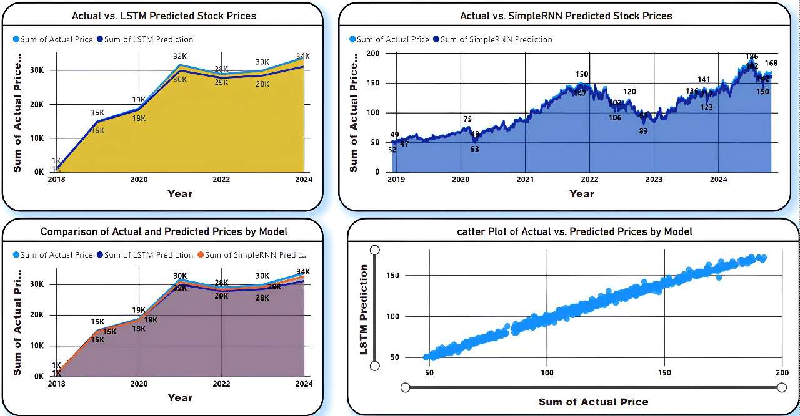
RESULT AND DISCUSSIONS
Chart 1: Actual vs. LSTM Predicted Stock Prices
Chart 2: Actual vs. SimpleRNN Predicted Stock Prices
Chart 3: Comparison of Actual and Predicted Prices by Model
Chart 4: Scatter Plot of Actual vs. Predicted Prices by Model
These charts collectively demonstrate that both the LSTM and SimpleRNN models are capable of capturing the overall trend in stock prices, with the LSTM model showing higher accuracy. The upward trend in stock prices is clearly depicted, along with increased stability in later years. The scatter plot further confirms the LSTM model's effectiveness, as its predictions closely align with actual prices.
Actual vs. LSTM and RNN Predicted Stock Prices

Slide 16
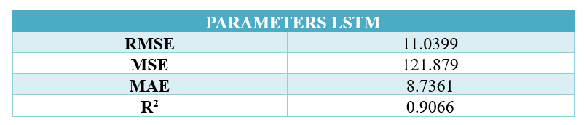
Performance analysis
The performance analysis of our model using Long Short-Term Memory (LSTM) neural networks on the stock market dataset indicates strong predictive accuracy. The RMSE and MAE values, which measure the average magnitude of errors in predictions, are relatively low, suggesting that the model's predictions are close to the actual values. The high R² value of 0.9066 indicates that approximately 90.66% of the variance in stock prices is explained by the model, pointing to a good fit. Overall, these metrics suggest that the LSTM model is effective in capturing stock price patterns, making it a reliable tool for forecasting in this context.

Slide 17
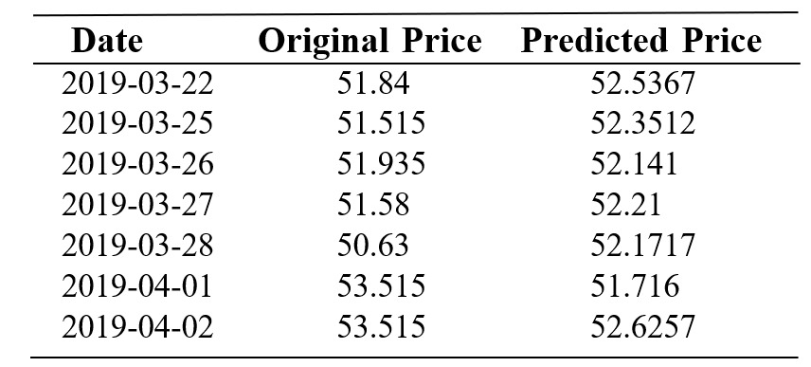
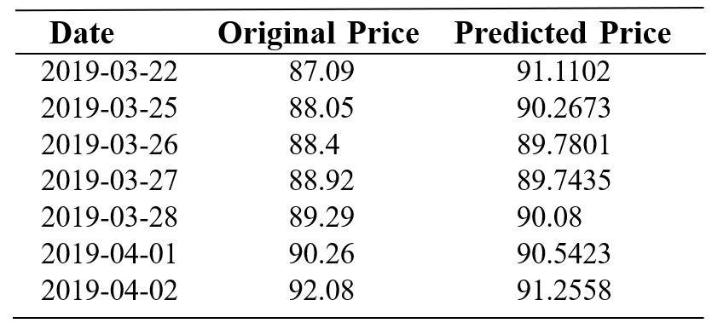
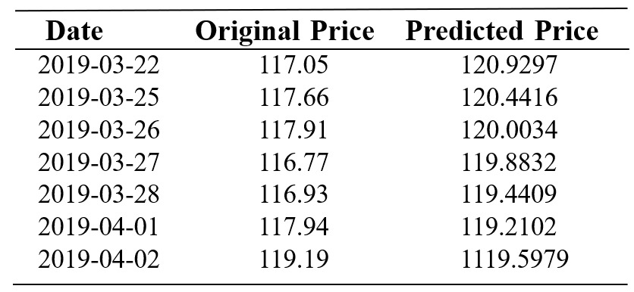
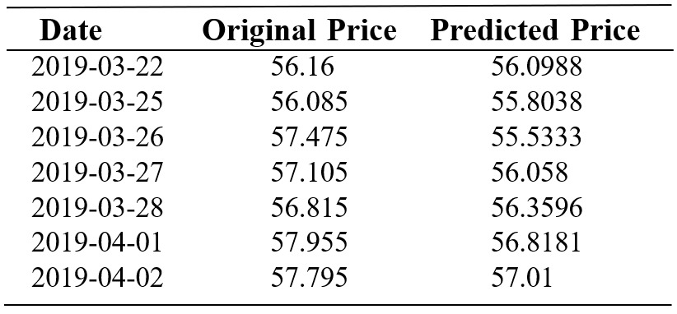
Actual vs Predicted in GOOGLE
Actual vs Predicted in RELIANCE
Actual vs Predicted in MICOSOFT
Actual vs Predicted in HDFC

Slide 18
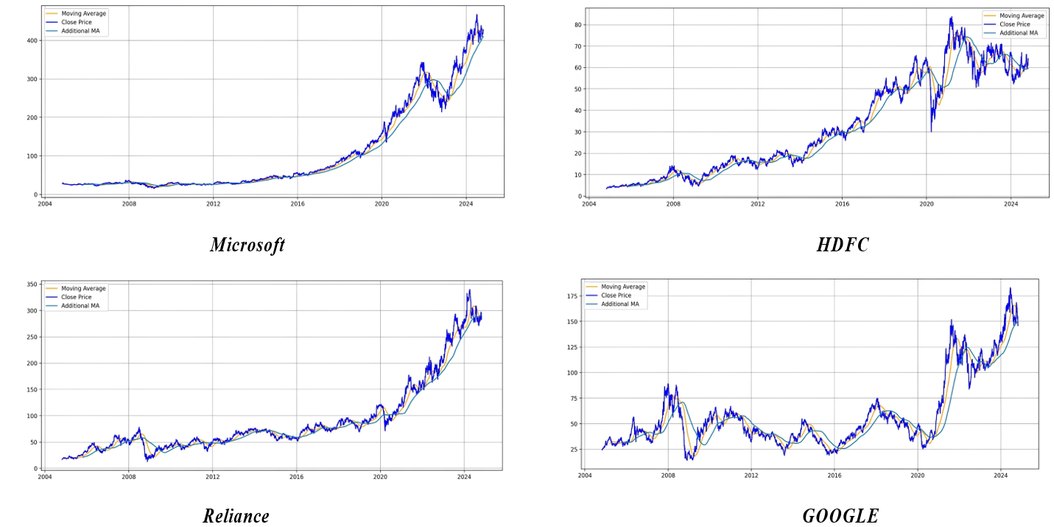
Original Close Price with MA for 100 days ,200 & 250 days

Slide 19
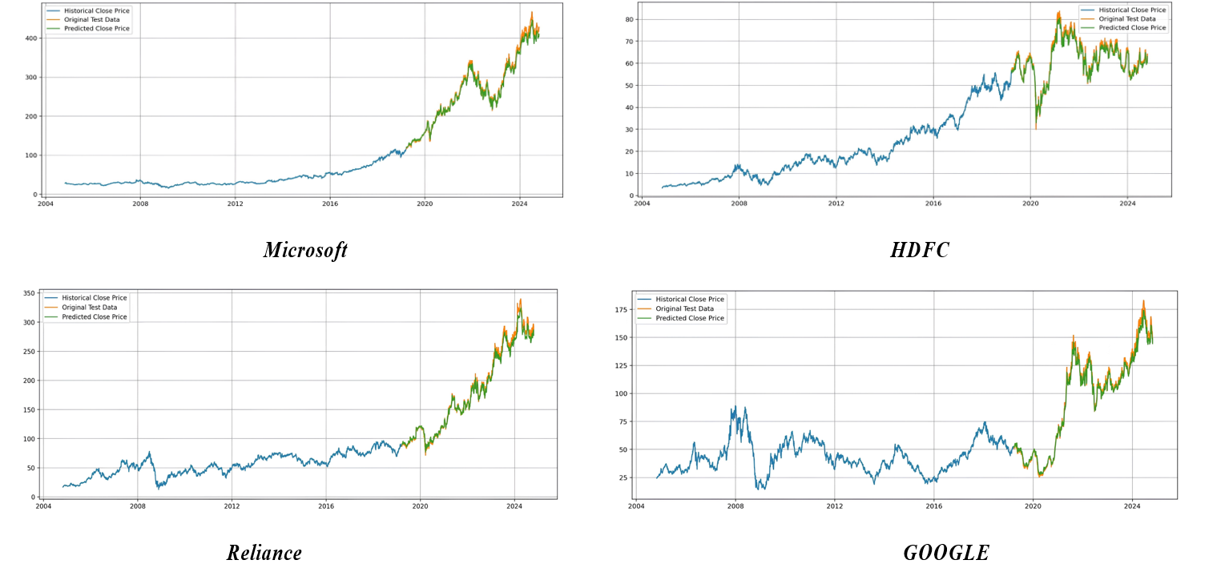
Original Close Price vs Predicted Close Price

Slide 20
CONCLUSION
This Stock Market Price Prediction project is designed to forecast stock prices based on historical data. The app’s user-friendly interface allows users to input a stock ticker (e.g., "GOOG") and select a date range, after which the app fetches relevant historical data from Yahoo Finance. A pre-trained LSTM model, known for capturing sequential dependencies in time-series data, is loaded to make predictions. The data is prepared by scaling and windowing, ensuring compatibility with the model’s requirements, and transformed back to the original scale for interpretable predictions. Additionally, the application features visualizations of moving averages over 100, 200, and 250 days, providing users with insights into both short & long term stock price trends. The app displays actual vs. predicted stock prices side by side, both in a table and on a line graph, giving users a clear view of the model’s performance. The LSTM model effectively captures overall price trends, though some deviations suggest areas for potential refinement. For a more comprehensive analysis, including error metrics like MAE & RMSE could help users better understand prediction accuracy. This project illustrates the power of combining machine learning with real-time data visualization to assist users in making informed investment decisions, with future potential to integrate additional models and real-time analysis capabilities to enhance accuracy and usability.Overall, this project highlights the capability of deep learning models to handle complex time-series data in the financial domain, making them powerful tools for real-time forecasting and analysis.

Slide 21
FUTURE SCOPE
This project shows promising results in stock price prediction using LSTM, but there are various areas where future improvements can be made. One direction is to incorporate additional features like macroeconomic indicators, sector-specific metrics, or even sentiment data from news and social media, which can influence stock prices. Advanced architectures, such as Transformers or hybrid models combining LSTM with attention mechanisms, could be explored to capture complex market patterns, especially during volatile periods. Additionally, implementing reinforcement learning could allow the model to not only predict prices but also optimize trading strategies by learning when to buy or sell based on predicted movements.
Further, enhancing the deployment and usability of the model could broaden its application. Currently deployed via Streamlit, it could be expanded into a mobile or web app for greater accessibility, with potential integration to broker APIs for automated trading. Real-time performance could be improved by leveraging cloud services optimized for low-latency applications, making it viable for high-frequency trading. Backtesting features would allow users to evaluate the model’s performance under historical market conditions, helping refine predictions. Ensemble approaches combining LSTM with other models like XGBoost or an ensemble of deep learning models could further enhance prediction accuracy, providing a more robust and comprehensive tool for investors and institutions alike.

Slide 22
REFERENCES
[1]Ricchiuti, F., & Sperlí, G. (2024). An Advisor Neural Network framework using LSTM-based Informative Stock Analysis. Expert Systems with Applications, 125299.
[2]Lin, C. Y., & Marques, J. A. L. (2024). Stock market prediction using Artificial Intelligence: A systematic review of Systematic Reviews. Social Sciences & Humanities Open, 9, 100864.
[3]Uçkan, T. (2024). Integrating PCA with deep learning models for stock market Forecasting: An analysis of Turkish stocks markets. Journal of King Saud University-Computer and Information Sciences, 36(8), 102162.
[4]Safari, A., & Badamchizadeh, M. A. (2024). DeepInvest: Stock Market Predictions with a Sequence-Oriented BiLSTM Stacked Model–A Dataset Case Study of AMZN. Intelligent Systems with Applications, 200439.
[5]Yao, D., & Yan, K. (2024). Time series forecasting of stock market indices based on DLWR-LSTM model. Finance Research Letters, 68, 105821.

